Slide 1


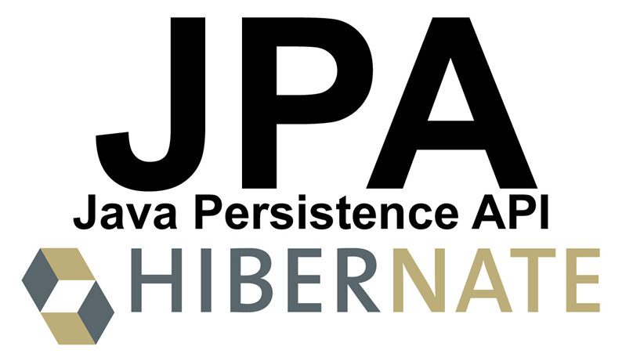

JPA (Java Persistence API)
Java ORM, JPA and Hibernate CRUD Operations with JPA
JPA
SoftUni Team
Technical Trainers
Software University
http://softuni.bg

Slide 2



Table of Contents
ORM Frameworks
JPA (Java Persistence API)
Install and Configure JPA
Mapping the DB Schema with JPA Annotations
CRUD Operations
Query Entities
Create, Update, Delete Entities

Slide 3
Have a Question?
sli.do #4216

Slide 4
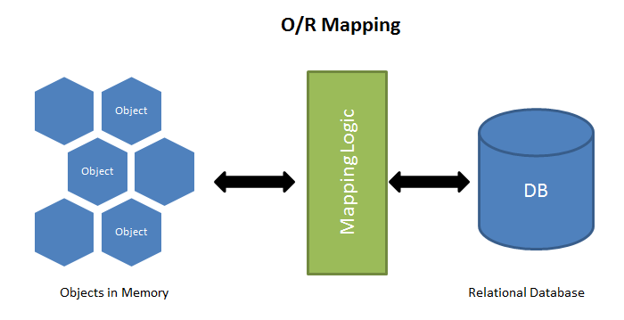
ORM Frameworks – Overview
ORM Frameworks map OOP classes to database tables

Slide 5
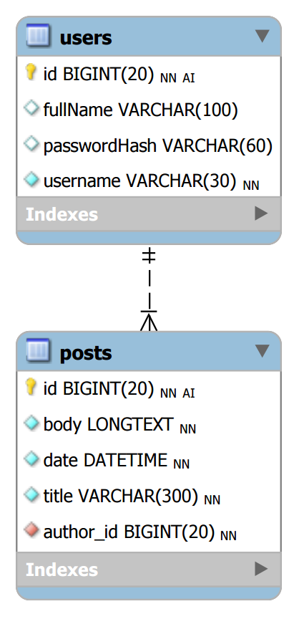
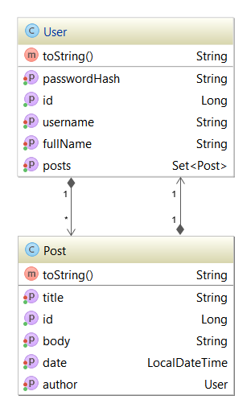




Mapping DB Tables to Classes
Relational DB Schema
ORM
Framework
Java Entity Classes

Slide 6

ORM Frameworks – Features
C# / Java / PHP classes are mapped to DB tables
DB relationships are mapped to class associations
ORM provides API for CRUD operations
List objects / query database
Create new object
Update existing object
Delete existing object
Some ORMs provide schema synchronization (DB migrations)
CRUD operations execute
SQL commands in the DB

Slide 7
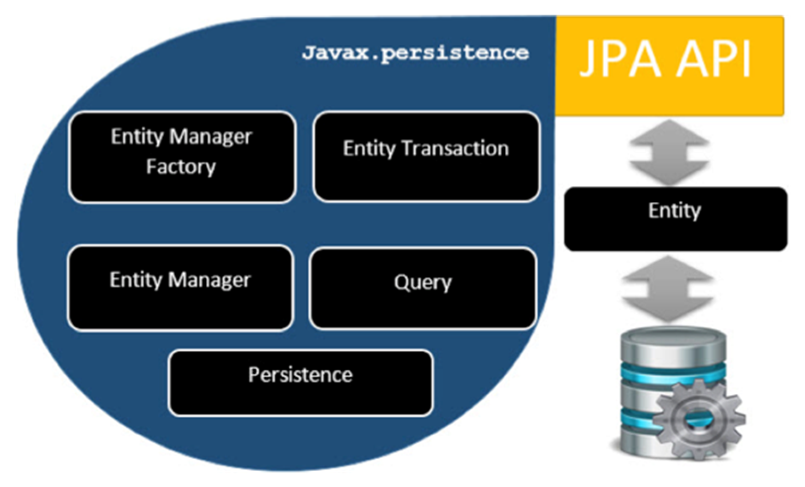
JPA – Java Persistence API

Slide 8
Starting with JPA: Maven Dependencies
pom.xml
<dependencies>
<dependency>
<groupId>org.hibernate</groupId>
<artifactId>hibernate-core</artifactId>
<version>5.2.1.Final</version>
</dependency>
<dependency>
<groupId>mysql</groupId>
<artifactId>mysql-connector-java</artifactId>
<version>6.0.3</version>
</dependency>
</dependencies>
Include library "hibernate-core"
Include library "mysql-connector-java"

Slide 9
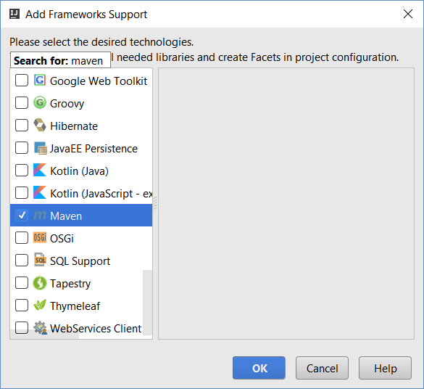
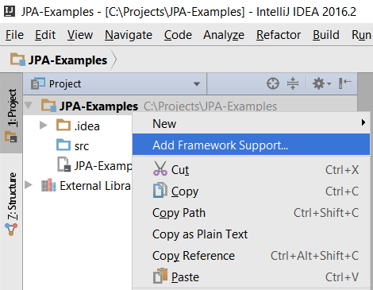

IntelliJ IDEA: Add Maven Support

Slide 10
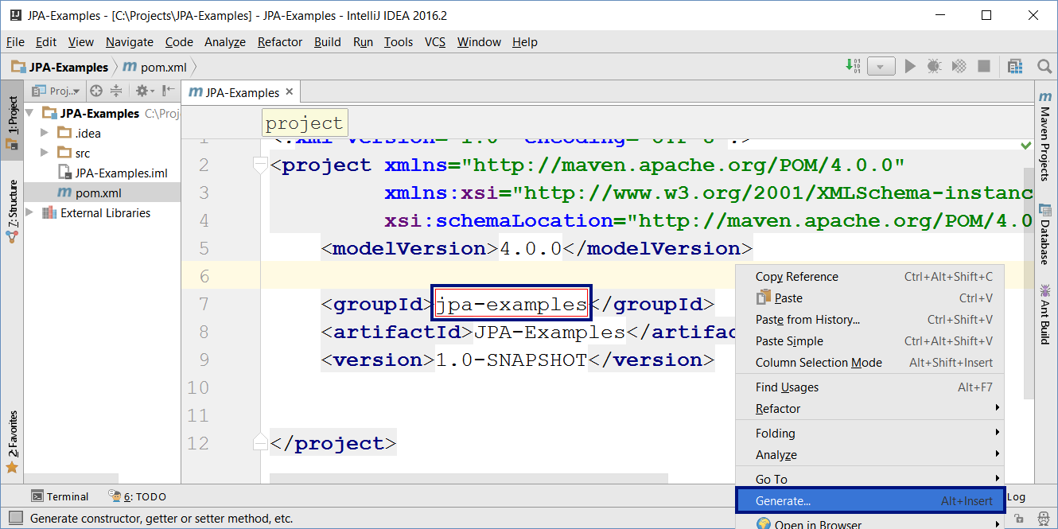
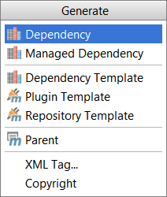
IntelliJ IDEA: Add Maven Dependencies

Slide 11
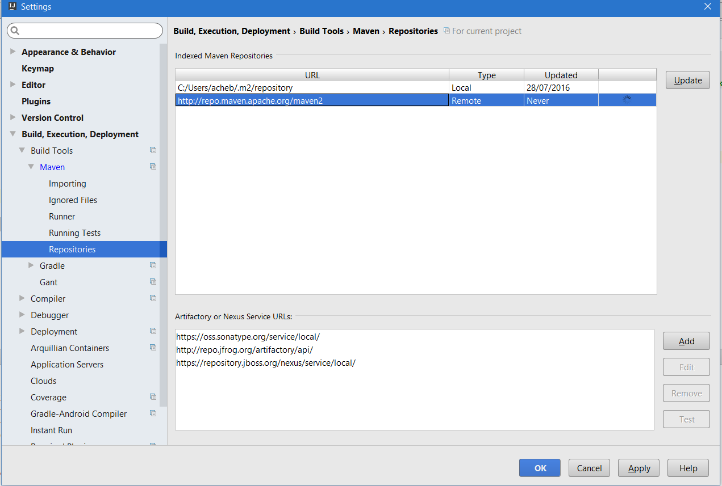
IntelliJ IDEA: Add Maven Dependencies (2)

Slide 12
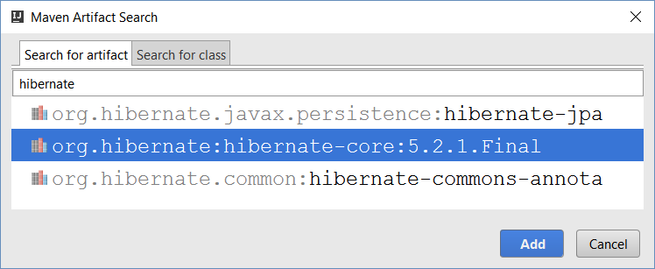
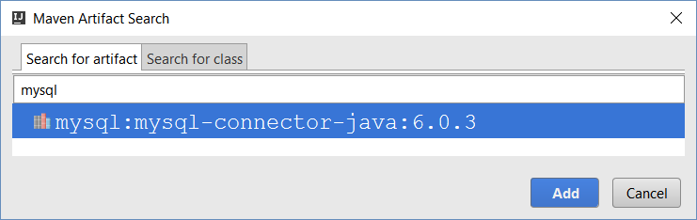
IntelliJ IDEA: Add Maven Dependencies (3)

Slide 13
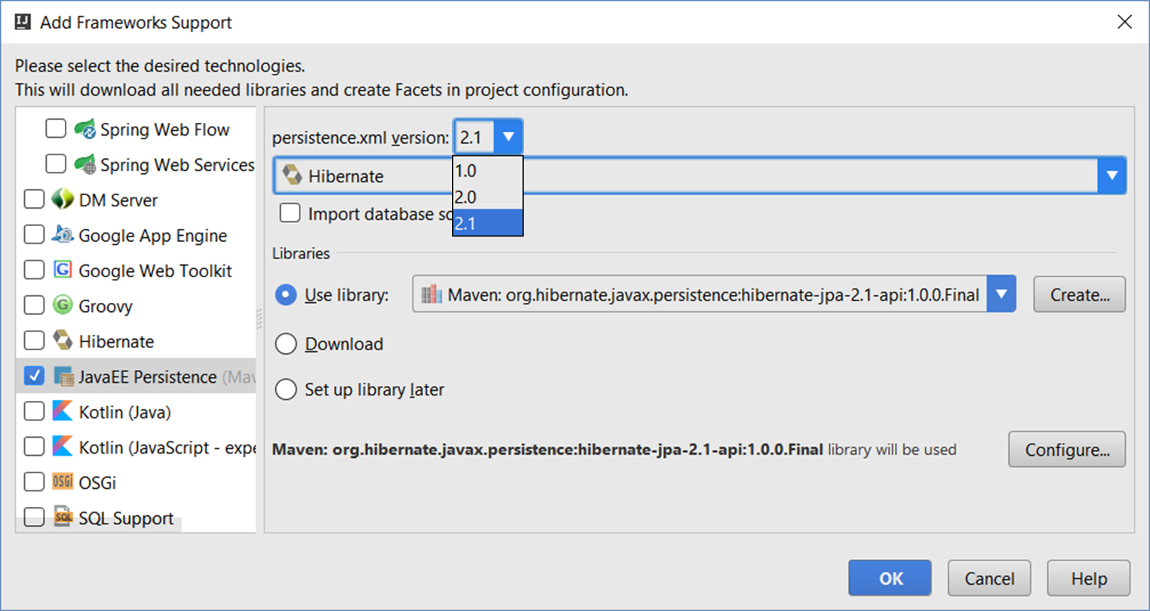
IntelliJ IDEA: Add JPA Support

Slide 14
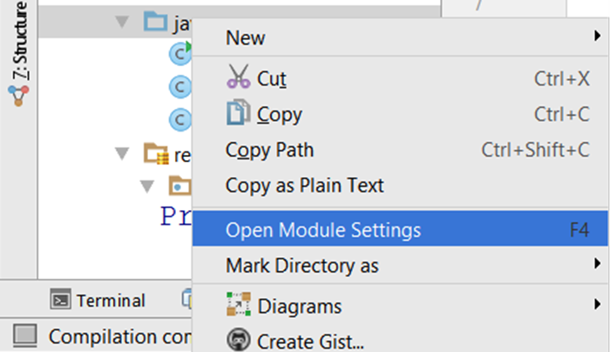
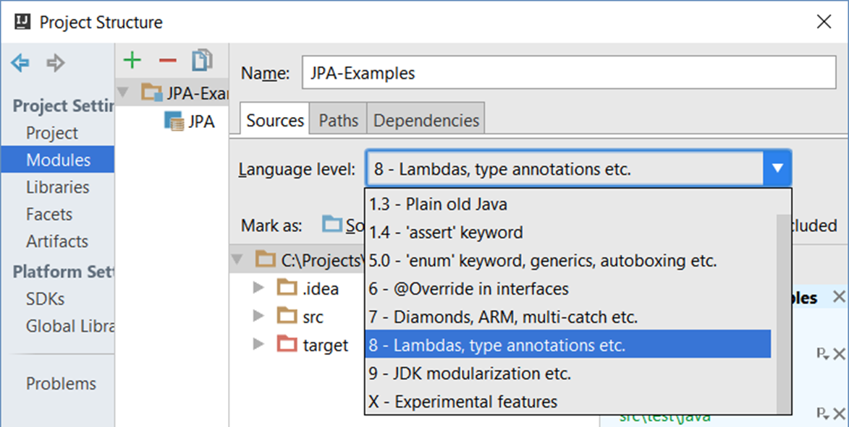
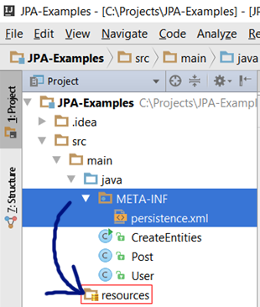
IntelliJ IDEA Bugs: JPA + Maven
Move META-INF + persistence.xml to resources folder
Use Java 8

Slide 15
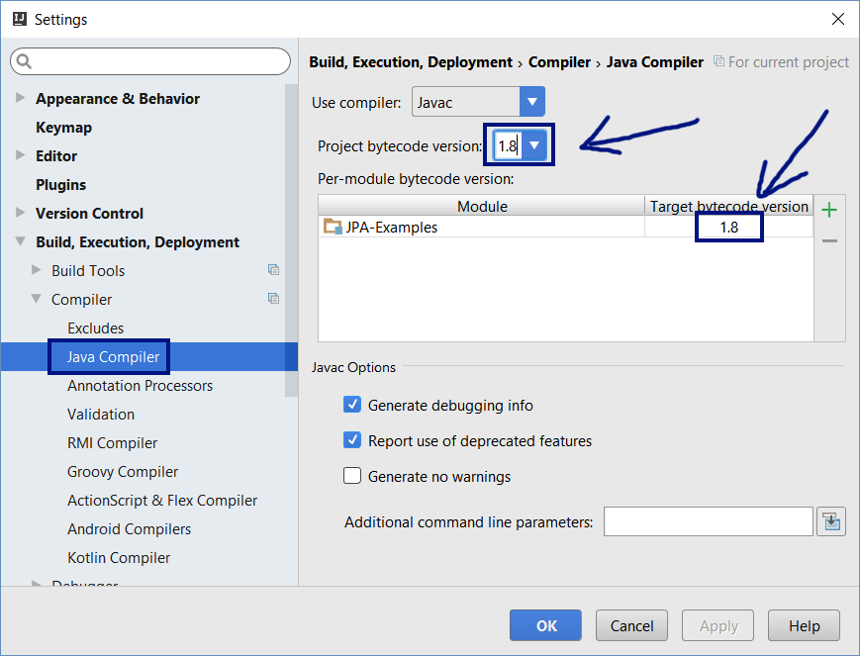
IntelliJ IDEA Bugs: Java 8 Is Not Default

Slide 16
The JPA Configuration: persistence.xml
Create the JPA configuration file to connect to blog_db
resources\META-INF\persistence.xml
<persistence xmlns="http://xmlns.jcp.org/xml/ns/persistence" version="2.1">
<persistence-unit name="blog-db">
<properties>
<property name="javax.persistence.jdbc.driver" value="com.mysql.cj.jdbc.Driver" />
<property name="javax.persistence.jdbc.url" value="jdbc:mysql://localhost/blog_db" />
<property name="javax.persistence.jdbc.user" value="root" />
<property name="javax.persistence.jdbc.password" value="" />
<property name="hibernate.connection.characterEncoding" value="utf-8" />
<property name="hibernate.show_sql" value="false" />
<property name="hibernate.format_sql" value="true" />
<property name="hibernate.hbm2ddl.auto" value="create" />
</properties>
</persistence-unit>
</persistence>
Configure the DB connection string
Use "create" or "update"

Slide 17
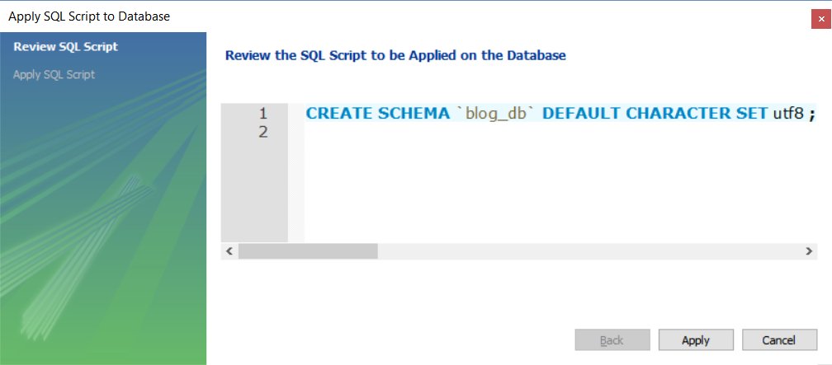
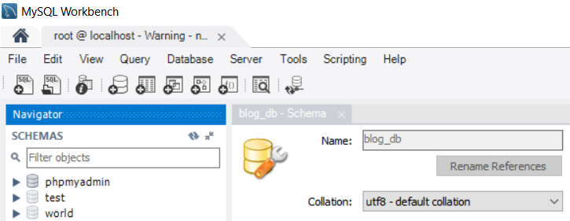
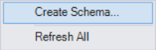
Create Empty MySQL Database: blog_db

Slide 18
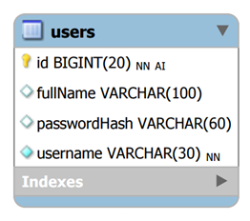
Entity Class: User
User.java
@Entity @Table(name = "users")
public class User {
@Id @GeneratedValue(strategy = GenerationType.IDENTITY)
private Long id;
@Column(nullable = false, length = 30, unique = true)
private String username;
@Column(length = 60)
private String passwordHash;
@Column(length = 100)
private String fullName;
@OneToMany(mappedBy = "author")
private Set<Post> posts = new HashSet<Post>();
}
Generate also getters / setters / toString()

Slide 19
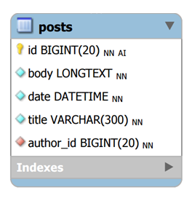
Entity Class: Post
Post.java
@Entity @Table(name = "posts")
public class Post {
@Id @GeneratedValue(strategy = GenerationType.IDENTITY)
private Long id;
@Column(nullable = false, length = 300)
private String title;
@Lob @Column(nullable = false)
private String body;
@ManyToOne(optional = false)
private User author;
@Column(nullable = false)
private LocalDateTime date = LocalDateTime.now();
}
Generate also getters / setters / toString()

Slide 20

JPA – Java Persistence API
Persistence
import javax.persistence.*;
==
JPA
createEntityManagerFactory()
Query
EntityManagerFactory
setParameter()
getResultList()
getSingleResult()
executeUpdate()
Entity
Entity
Entity
createEntityManager()
id
field1
field2
id
field1
field2
id
field1
field2
EntityManager
EntityTransaction
getTransaction()
find() / createQuery()
persist()
remove()
begin()
commit()
rollback()

Slide 21
Create New User
EntityManagerFactory emf = Persistence
.createEntityManagerFactory("blog-db");
EntityManager em = emf.createEntityManager();
try {
User newUser = new User();
newUser.setUsername("pesho");
em.getTransaction().begin();
em.persist(newUser);
em.getTransaction().commit();
System.out.println("Created new user #" + newUser.getId());
}
finally {
em.close();
emf.close();
}
Persistence unit from persistence.xml
Using a transaction is obligatory!
persist() will execute an SQL INSERT
Always close the Entity Manager + Factory

Slide 22



Maven + JPA + Hibernate
Live Exercise in Class (Lab)

Slide 23
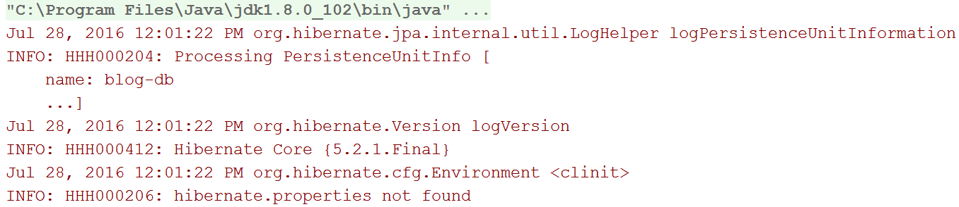
Configure Hibernate Logging
Hibernate shows a lot of INFO / WARNING / DEBUG / ERROR logs
Disable the informational logs from "org.hibernate" package
Put this at the first line in your main(…) method
Logger.getLogger("org.hibernate").setLevel(Level.SEVERE);

Slide 24
Configure java.util.logging
Edit %JAVA_HOME%\jre\lib\logging.properties
# Log levels: SEVERE, WARNING, INFO, CONFIG, FINE, FINER, FINEST
# Default global logging level (for all loggers)
.level = INFO
# Logging level for all messages printed on the console
java.util.logging.ConsoleHandler.level = FINEST
# Logging levels for Hibernate messages (show SQL)
org.hibernate.level = SEVERE
org.hibernate.SQL.level = FINE
org.hibernate.type.descriptor.sql.level = FINEST

Slide 25
Create New User + Several Posts
em.getTransaction().begin();
User newUser = new User();
newUser.setUsername("pesho" + new Date().getTime());
newUser.setPasswordHash("pass12345"); newUser.setFullName("P.Petrov");
em.persist(newUser);
System.out.println("Created new user #" + newUser.getId());
for (int i = 1; i <= 10; i++) {
Post newPost = new Post();
newPost.setTitle("Post Title " + i);
newPost.setBody("<p>Body" + i + "</p>");
newPost.setAuthor(newUser);
em.persist(newPost);
System.out.println("Created new post #" + newPost.getId());
}
em.getTransaction().commit();

Slide 26
Query Data: List All Posts
Query allPostsQuerySlow = em.createQuery(
"SELECT p FROM Post p");
Query allPostsQuery = em.createQuery(
"SELECT p FROM Post p JOIN FETCH p.author");
List<Post> posts =
allPostsQuery.getResultList();
for (Post post : posts) {
System.out.println(post);
}
Use JOIN FETCH to avoid the "N+1 query problem"

Slide 27
Query Data: Posts by Username
Fetch the post author alogn with the post
Query peshoPosts =
em.createQuery(
"FROM Post p JOIN FETCH p.author " +
"WHERE p.author.username " +
"LIKE CONCAT(:username, '%') ")
.setParameter("username", "pesho");
List<Post> posts = peshoPosts.getResultList();
for (Post post : posts) {
System.out.println(post);
}
Bind a parameter
:username

Slide 28
Look at the Generated SQL Code
SELECT post0_.id as id1_0_0_,
user1_.id as id1_1_1_,
post0_.author_id as author_i5_0_0_,
post0_.body as body2_0_0_,
post0_.date as date3_0_0_,
post0_.title as title4_0_0_,
user1_.fullName as fullName2_1_1_,
user1_.passwordHash as password3_1_1_,
user1_.username as username4_1_1_
FROM posts post0_
INNER JOIN users user1_ ON post0_.author_id = user1_.id
WHERE user1_.username LIKE CONCAT(?, '%')

Slide 29
Edit Existing User
// Load an existing user by ID
User firstUser = em.find(User.class, 1L);
// Modify the User
firstUser.setPasswordHash("" + new Date().getTime());
firstUser.setFullName(firstUser.getFullName() + "2");
// Persist pending changes
em.getTransaction().begin();
em.persist(firstUser);
em.getTransaction().commit();
System.out.println(
"Edited existing user #" + firstUser.getId());

Slide 30
Delete Existing User
// Load an existing user by ID
User firstUser = em.find(User.class, 1L);
// Delete the user along with its posts
em.getTransaction().begin();
for (Post post : firstUser.getPosts())
em.remove(post);
em.remove(firstUser);
em.getTransaction().commit();
System.out.println("Deleted existing user #" +
firstUser.getId());

Slide 31
Execute Native SQL
LocalDateTime startDate =
LocalDateTime.parse("2016-05-19T12:00:00");
LocalDateTime endDate = LocalDateTime.now();
Query postsQuery = em.createNativeQuery(
"SELECT id, title, date, body, author_id FROM posts " +
"WHERE CONVERT(date, Date) " +
"BETWEEN :startDate AND :endDate", Post.class)
.setParameter("startDate", startDate)
.setParameter("endDate", endDate);
List<Post> posts = postsQuery.getResultList();
for (Post post : posts)
System.out.println(post);

Slide 32
CRUD Operations with JPA
Live Exercise in Class (Lab)

Slide 33

Summary
ORM Frameworks maps DB tables to classes
Provide API for queries and CRUD operations
JPA + Hibernate is ORM framework for Java
EntityManager provides CRUD + queries
EntityManagerFactory emf = Persistence
.createEntityManagerFactory("blog-db");
EntityManager em = emf.createEntityManager();
User user = em.find(User.class, 1L);

Slide 34








JPA (Java Persistence API)
https://softuni.bg/courses/software-technologies

Slide 35
License
This course (slides, examples, demos, videos, homework, etc.) is licensed under the "Creative Commons Attribution-NonCommercial-ShareAlike 4.0 International" license

Slide 36






Free Trainings @ Software University
Software University Foundation – softuni.org
Software University – High-Quality Education, Profession and Job for Software Developers
softuni.bg
Software University @ Facebook
facebook.com/SoftwareUniversity
Software University @ YouTube
youtube.com/SoftwareUniversity
Software University Forums – forum.softuni.bg

